Slide 1
Cognition Fundamentals: Refresher
Cognitive Models of Language Learning & Large Language Models
Responsible Lecturer: Bram Heijligers

Slide 2
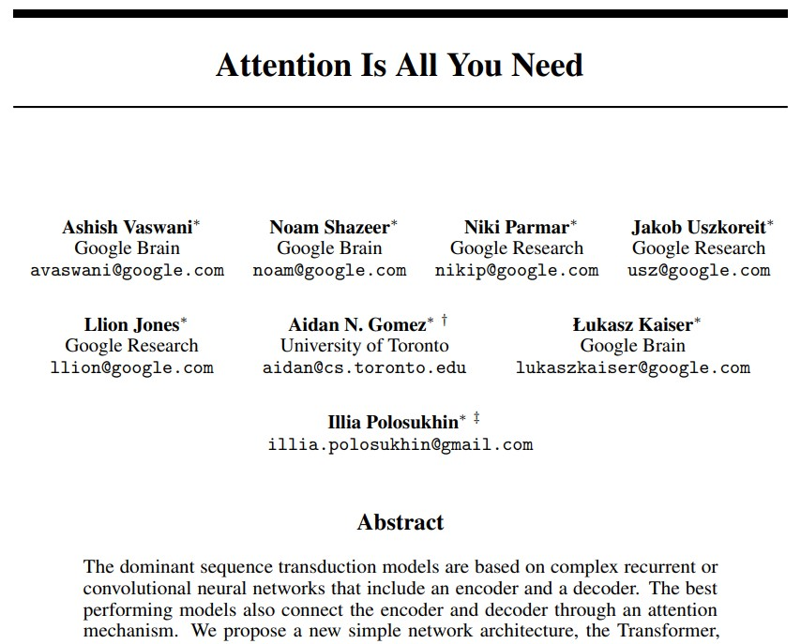
Going full-circle...

Slide 3
Table of Contents
Recap of:
Book chapter 1 - 5
---- SHORT BREAK ----
Large Language Models & Cognition
Recurrent Neural Networks
Transformers
How they connect
Afternoon:
Use-case 2 walkthrough
Feedback & Q&A

Slide 4
How do we learn language?
How do we acquire meaning?

Slide 5
What is Modelling of Language Learning?
Human language learning
Identify processes and mechanisms involved in learning language
Detect common behavioural patterns among humans; specifically children
(Computational) modelling
Simulate a cognitive process via computational tools and techniques
Use the model to explain the observed human behaviour
Modelling of language learning
Develop computational simulations of the process of human language acquisition

Slide 6
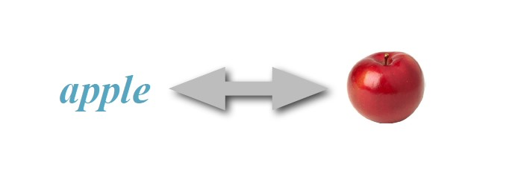
Learning Words
Learning the meaning of words: associating a mental
representation, or concept, with a word form

Slide 7
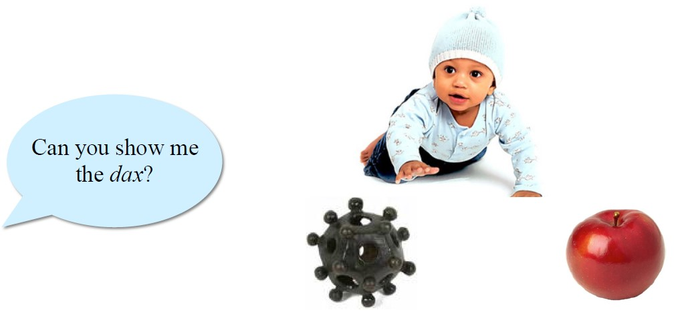
Word Meaning
Young children easily map novel words to novel objects in
familiar context
However, mapping words alone is not enough...

Slide 8
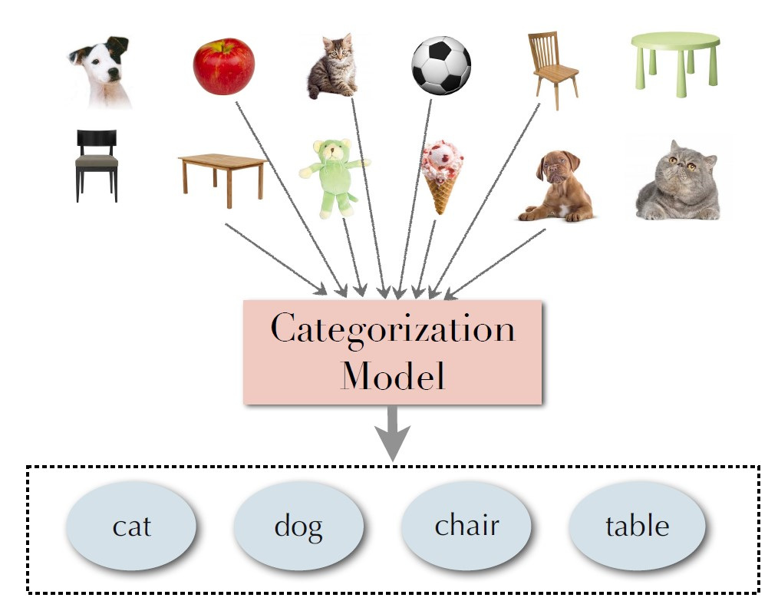
Assigning Meaning to a word
It all start with categories...
We all like to put things in boxes
Makes our lives easier
It’s the most basic component to assign meaning
Neural networks for language representation and acquisition
Different levels of linguistic representation are emergent structures that a network develops in the course of learning

Slide 9
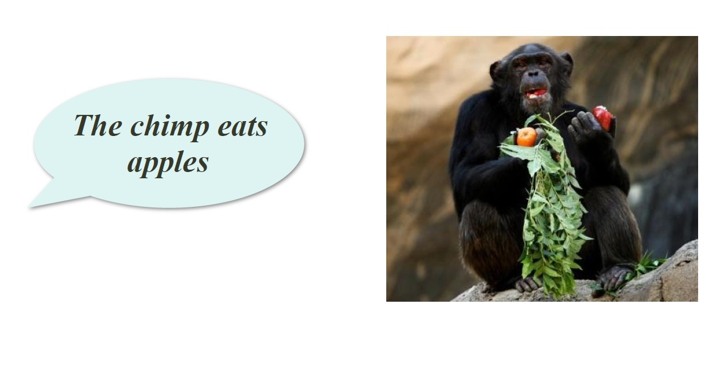
Word(s) meaning
The world is often complex and many correlations are possible...
Agent → Event (Chimp eats) ; Agent → Event → Theme (above)

Slide 10
Suggested Learning Mechanisms
An overview for the use-cases...
Associative learning
Simple associative mechanisms are used to map a word form with a concept
Referential learning
A variety of attention mechanisms are used to narrow down the intended meaning
Cross-situational learning
Inferring correct word-meaning mappings by observing regularities across usages of a word

Slide 11
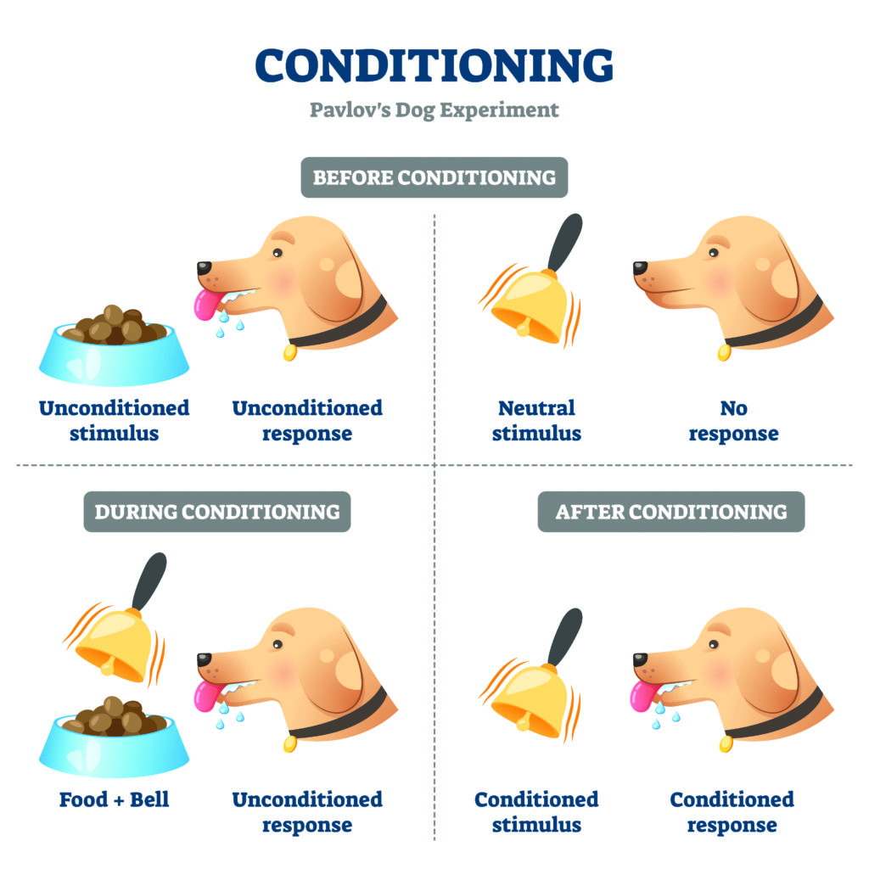
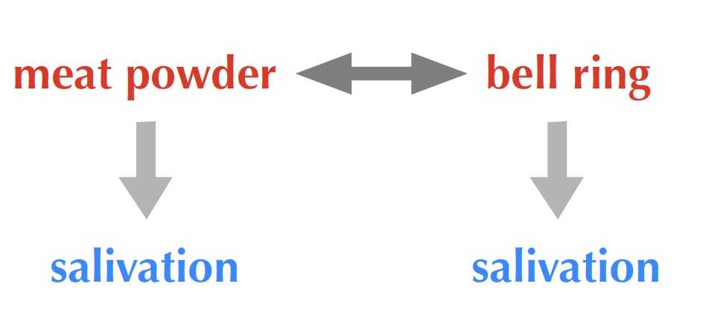
Associative Learning
Ideas and experiences reinforce one another
a new word form may be learned through repeated association to an already learned concept
Classic conditioning, e.g. Pavlov’s dog:

Slide 12

Referential Learning
Using specific biases for restricting the referents
Whole object bias: a novel word is likely to refer to the entirety of an object
Taxonomic bias: labels refer to objects of the same kind (often basic-level categories)
Using social and visual cues
Joint attention through pointing or gaze helps narrow down possible referents of a novel label: e.g cloud

Slide 13
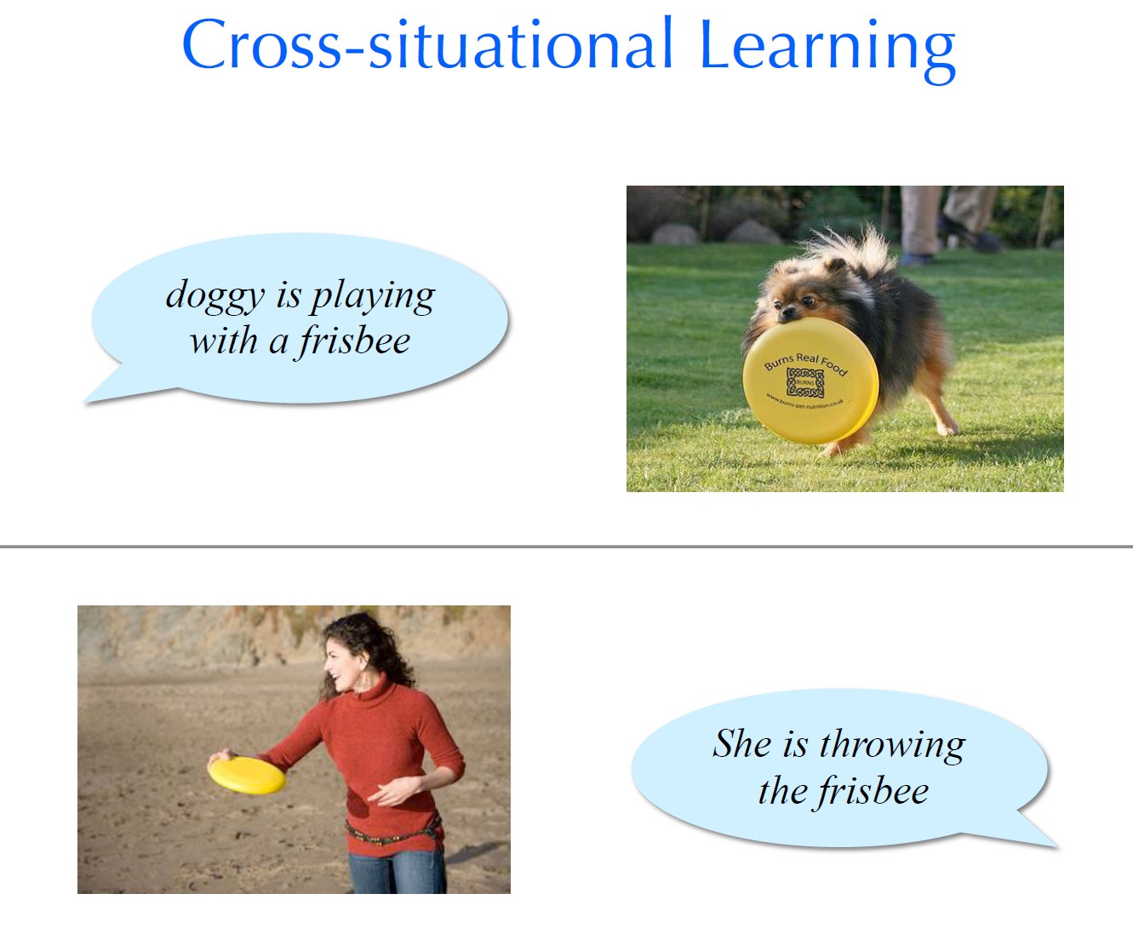
Cross-situational learning - Frisbee

Slide 14
Challenges of Word Learning
An overview for the use-cases...
Sentential context
Most words are not used in isolation, but in a multi-word utterance
Referential uncertainty
Learners may perceive aspects of a scene are unrelated to the utterance they hear
Noise
Error in perception or interpretation of the heard utterance or the observed scene

Slide 15
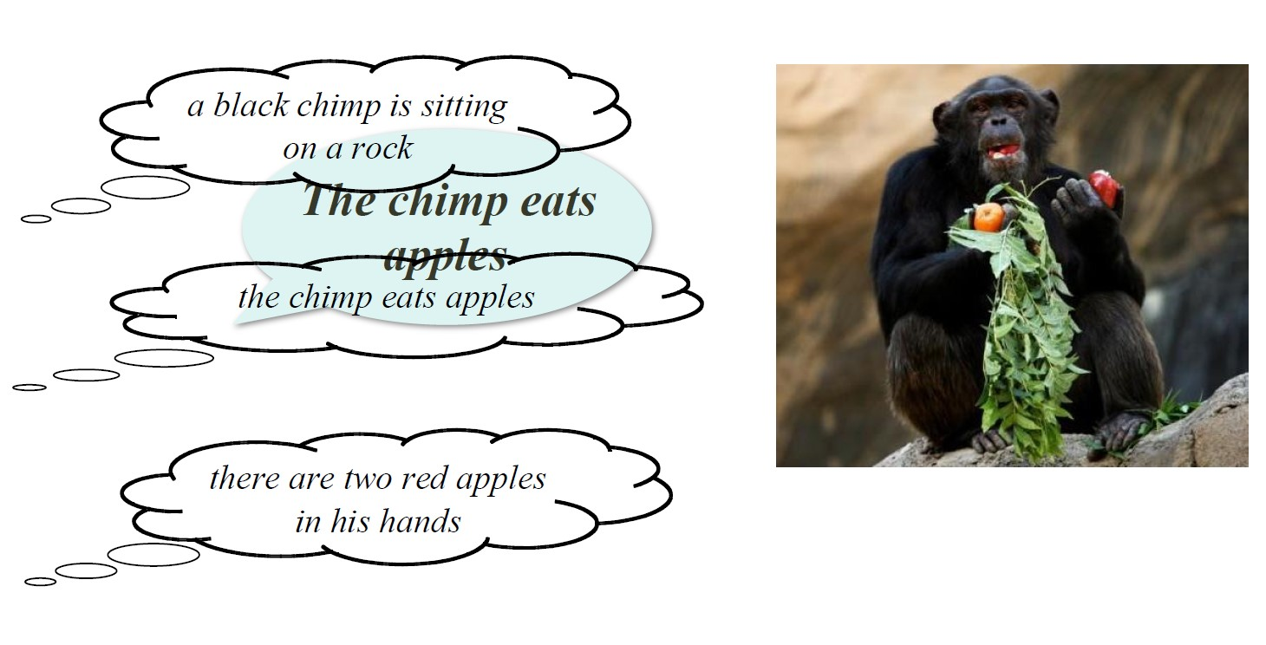
Word(s) meaning
Challenge: Referential Uncertainty

Slide 16
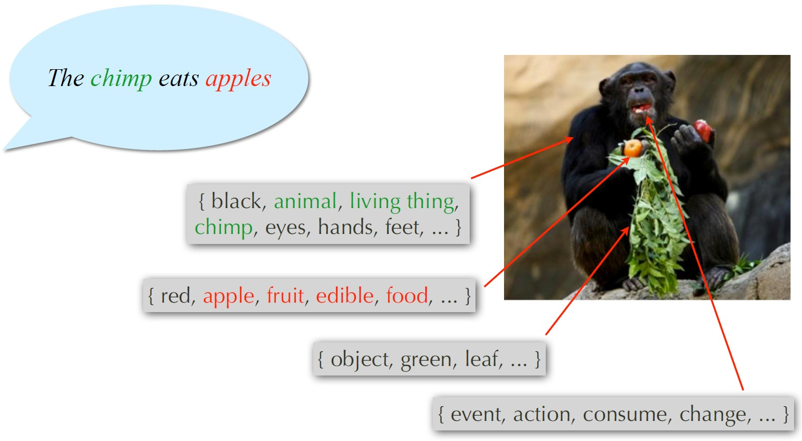
Word(s) meaning
Challenge: Sentential Context (Ambiguity)
Which word refers to which part of the meaning?

Slide 17
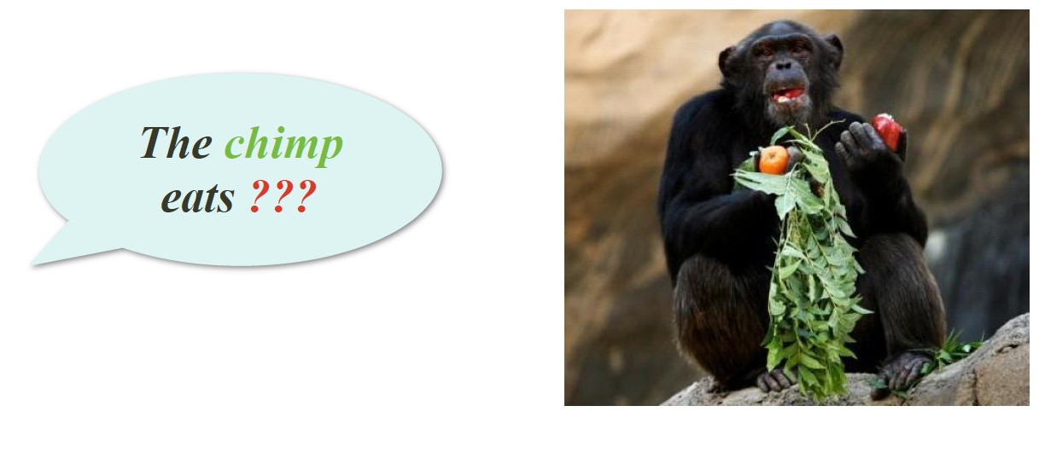
Word(s) meaning
Challenge: Perception Error (Noise)
Is the chimp eats what? Is the chimp eating?

Slide 18
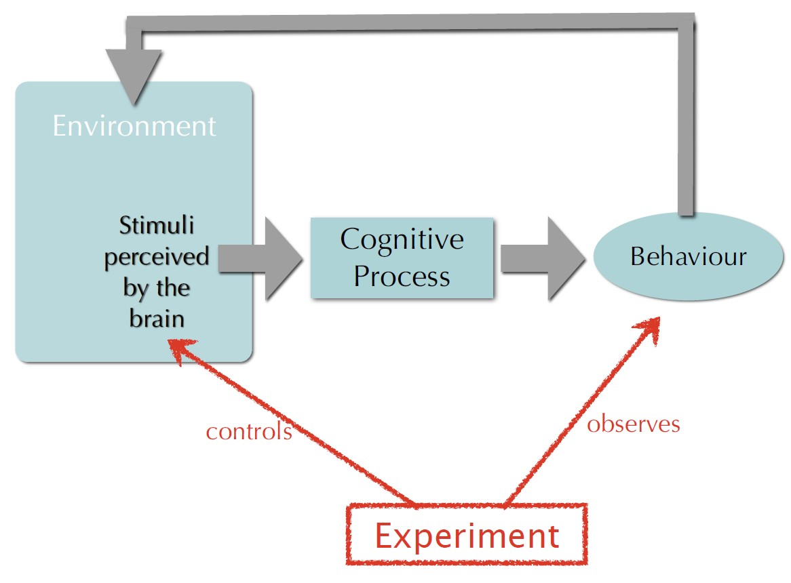
How do we learn about learning the meaning of a word?
More complex... That’s were science comes in...

Slide 19
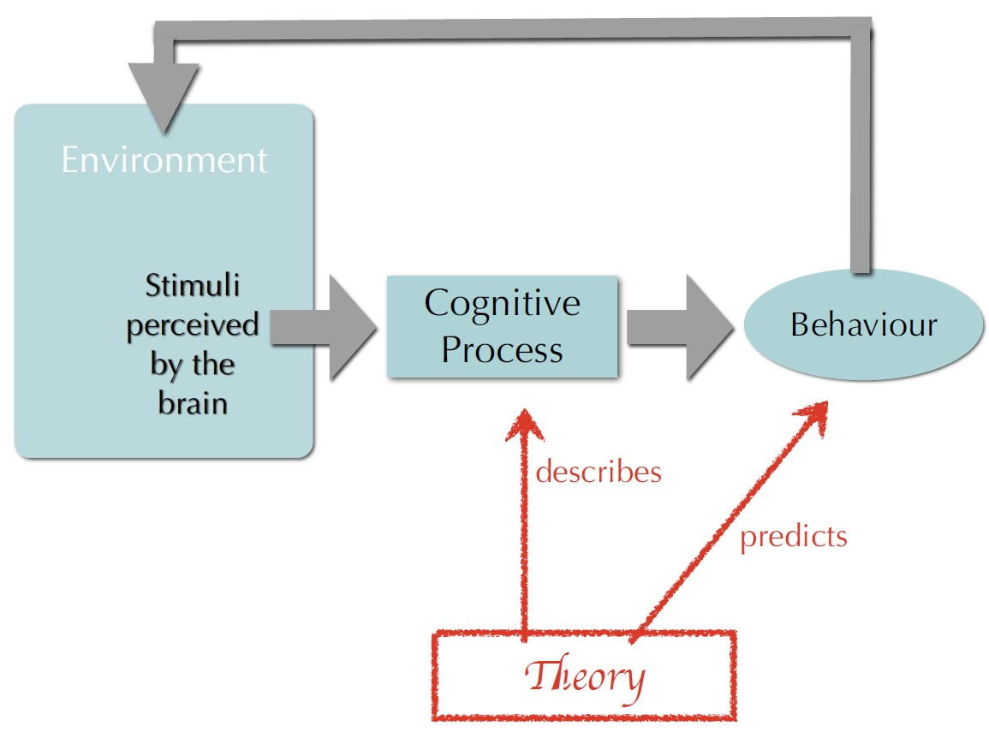
How do we learn about learning the meaning of a word?

Slide 20
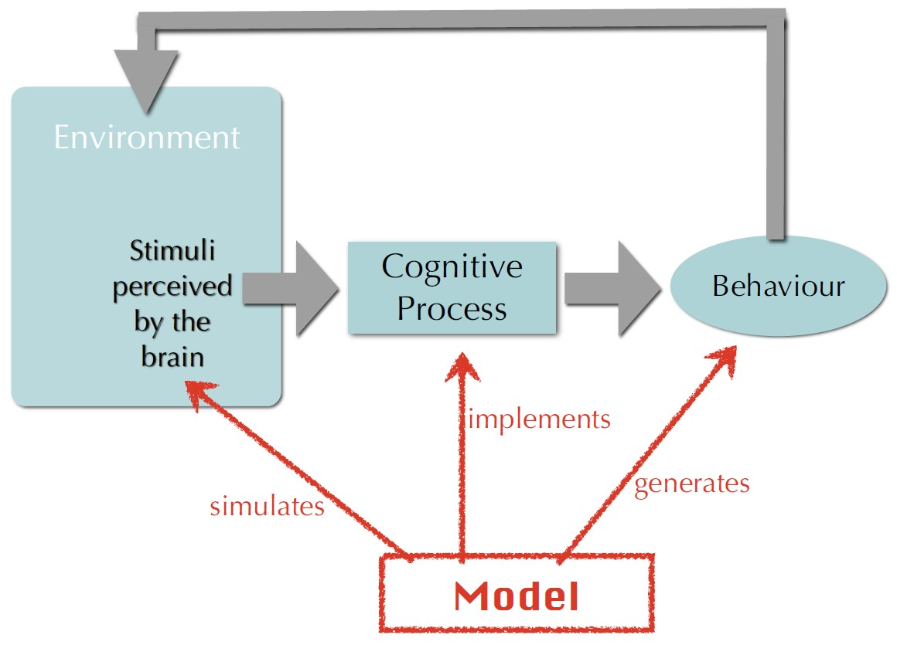
How do we learn about learning the meaning of a word?

Slide 21
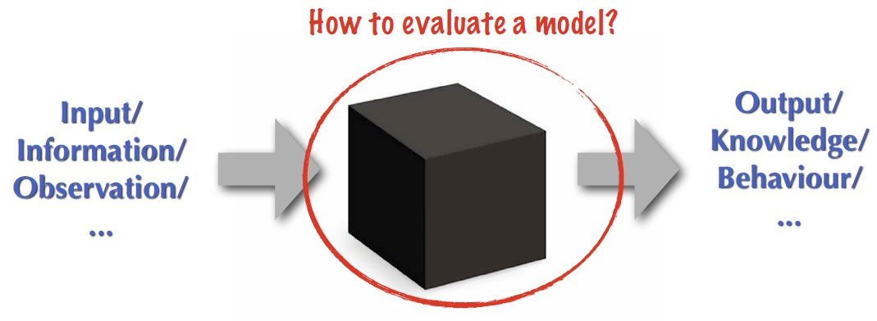
Language Acquisition Models:
How do we evaluate such models?
What humans know about language can only be estimated/evaluated through how they use it. Which means observing language:
Processing
Understanding
Production

Slide 22
Modelling Language Learning
Using computational methods for modelling cognitive processes of language learning enables us to:
study these processes through simulation;
evaluate the plausibility of existing theories of language learning and understanding;
explain the observed human behavior during the process of learning and using a natural language;
predict behavioural patterns that have not yet been experimentally investigated.

Slide 23
Various Aspects of Language Acquisition
Remember these for you use-cases!
Word segmentation: extract words from the speech stream, i.e.; splitting words into their respective parts
Phonology: acquire the sound system of the language, and the correct form of each word , i.e.; : how a language systematically organizes its sounds
Word meaning: map each word form to the concept it represents in the outer world
Morphology: learn the regularities governing the structure of each word form , i.e.; how a language systematically organizes its words and their respective relationships
Syntax: combine words and construct well-formed sentences , i.e.; the sentence structure and how it relates to phonology, morphology, sematics and pragmatics
Semantics: interpret the (relational) meaning of a phrase or sentence, i.e.; builds on syntax
Pragmatics and discourse: use context to augment the meaning , i.e.; how language is utilized in (social) interaction; builds on semantics
Idiosyncratic: peculiar or specific to

Slide 24
Types of modelling frameworks:
Symbolic: first generation of models influenced by early AI
Symbolic systems of knowledge representation; state-machine
Logic-based inference techniques; if-else
Connectionist: inspired by the architecture of human brain
Distributional representation of knowledge
Parallel processing of data
Probabilistic: following the success of statistical machine learning techniques
Combining descriptive power of symbolic models with the flexibility of the connectionist models
E.g. Large language models such as chatGPT

Slide 25
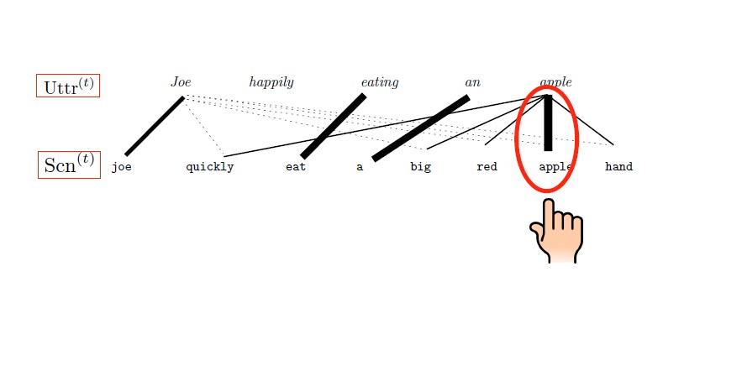
Computation simulation is complex
Example of encoding grammatical structure

Slide 26
Computation simulation is complex
But gives great insights!
Computational models require detailed specification of the input properties and the processing mechanism
Methodological advantage:
Explicit assumptions: all bias or constraint on the characteristics of the input data and learning mechanism are specified
Controlled input: researcher has full control over the input that the model receives in its life time
Observable behaviour: impact of every factor in the input or the learning process can be directly studied in the output
Testable predictions: novel situations or combinations of data can be simulated
But also takes a lot of time, and predicting and explaining something is very different; inference is much more complex...

Slide 27
That’s why we’re doing dry-runs of our flowcharts!
It’s much less exciting and cool, but you’re not training to be cognitive scientists, it should just help you explain your model!
CLICKLY-CLICKLY-CLICKY

Slide 28
Questions?
Let’s start working on use-case 2!

Slide 29
Break
Take a walk of 5 minutes and meet me at the Innovation Square!

Slide 30
How do artificial neural networks and cognition relate?
How does research into cognitive science drive developments in Artificial Intelligence?

Slide 31
Cognitive Models of Language Learning
Datalab Preparation!
A) Given the current developments surrounding large language models such as chatGPT, does the Innateness Hypothesis stand firm in your view?
B) And what about the Usage-based theories of language acquisition?

Slide 32
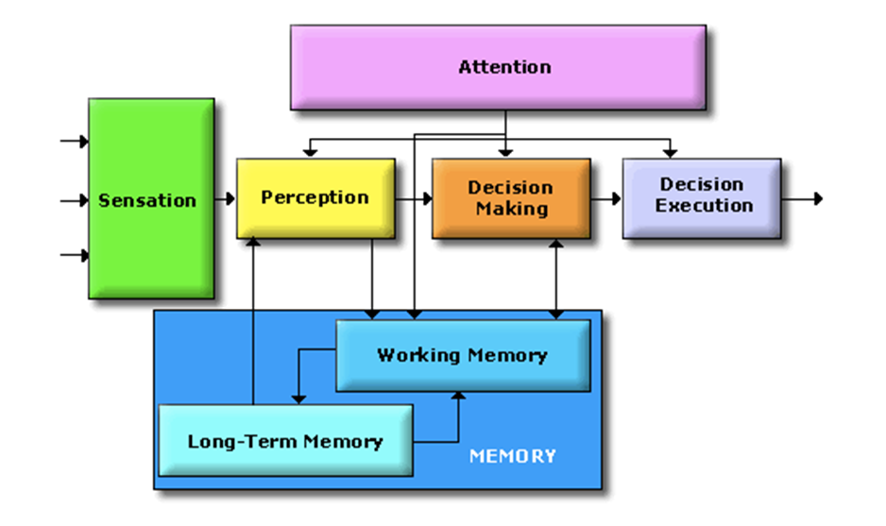
The Cognitive System
Which elements were present in your robotic AI?
Did it had sensors?
Was it able to perceive?
Was it able to make decisions and
execute these?
Was it able to store and retrieve
information?
So, what element here is not present in any of the AI system you have seen so far?
Why did we need attention?
Limited processing capacity → Selection!
To select the most relevant piece of information for the given context
Notes:
On the separate parts:
This approach is taken to aid clarity of explanation, but in so doing, can give the impression that individual aspects of cognition can be understood in isolation from each other. However, it is always important to remember that to properly understand the role of any single aspect of cognition we must appreciate how that role is dependent upon and interacts with other aspects.

Slide 33
Let’s translate a simple sentence to [Target Language]...
The cat eats the mouse.

Slide 34
How would we go about this? - RNN
The cat eats the mouse. → [Target Sentence in German]
Encode sentence to vector and decode sentence vector to target
Traditionally called sack-to-sack tasks
[0,0,0,0,0,0,0,0,0,0,0,0,0,0,0,0,0,0,0,0,0,0,0,0,0]
[Target Sentence]

Slide 35
How would we go about this? - RNN
The cat eats the mouse → [Target Sentence in German]
Sack-to-sack task
Traditionally done with Recurrent Neural Network
E.g. Alice TN Network
Other early translators often gave strange results
Encode to words to word vectors (token)
Turn it into hidden state (H0) using Encoder (E)
[0,0,0] [0,0,0] [0,0,0,0] [0,0,0] [0,0,0,0,0]
E
Encoder
H0
Hidden State
Notes:
Hidden State = The hidden state in a RNN is basically just like a hidden layer in a regular feed-forward network - it just happens to also be used as an additional input to the RNN at the next time step. Where f is some non-linear function, Wxh is a weight matrix of size h×x, and Whh is a weight matrix of size h×h.
Encoder = The encoder is built by stacking recurrent neural network (RNN). We use this type of layer because its structure allows the model to understand context and temporal dependencies of the sequences. The output of the encoder, the hidden state, is the state of the last RNN timestep

Slide 36
How would we go about this? - RNN
The cat eats the mouse → [Target Sentence in German]
Encode words into word vectors
Turn word vectors into hidden state (H0) using Encoder (E)
Hidden State get plugged into the encoder of the next word vector
[0,0,0] [0,0,0] [0,0,0,0] [0,0,0] [0,0,0,0,0]
E
E
H0

Slide 37
How would we go about this? - RNN
The cat eats the mouse → [Target Sentence in German]
Encode words into word vectors
Turn word vectors into hidden state (H0) using Encoder (E)
Hidden State get plugged into the encoder of the next word vector
However, usually there is also a ‘hidden-start-state’
Either learned from previous datasets or initialized with zeros
To which human cognition element could this correspond?
[0,0,0] [0,0,0] [0,0,0,0] [0,0,0] [0,0,0,0,0]
E
E
H
Start
H0
Notes:
We would start by encoding the sentence to vectors and then decode it again. Somehow, the sentence needs to go into a vector. Translating these is traditionally called a sack-to-sack task

Slide 38
How would we go about this? - RNN
The cat eats the mouse → [Target Sentence in German]
From the previous hidden state and the current word vector, the encoder again predicts another hidden state
[0,0,0] [0,0,0] [0,0,0,0] [0,0,0] [0,0,0,0,0]
E
E
H
Start
H0
H1
Notes:
We would start by encoding the sentence to vectors and then decode it again. Somehow, the sentence needs to go into a vector. Translating these is traditionally called a sack-to-sack task

Slide 39
How would we go about this? - RNN
The cat eats the mouse → [Target Sentence in German]
From the previous hidden state and the current word vector, the encoder again predicts another hidden state
And so on...
So this is a Recurrent Neural Network
Because it’s obviously recurrent...
[0,0,0] [0,0,0] [0,0,0,0] [0,0,0] [0,0,0,0,0]
E
E
E
E
E
H
Start
H0
H1
H2
H3
H4
Notes:
We would start by encoding the sentence to vectors and then decode it again. Somehow, the sentence needs to go into a vector. Translating these is traditionally called a sack-to-sack task

Slide 40
How would we go about this? - RNN
The cat eats the mouse → [Target Sentence in German]
Let’s start translating...
The last hidden state (H4) of the target sentence is then fed into the decoder which predicts the next word
And the process repeats; or is recurrent
[0,0,0] [0,0,0] [0,0,0,0] [0,0,0] [0,0,0,0,0]
E
E
E
E
E
H
Start
H0
H1
H2
H3
H4
Die Katze
D
D
D
H5
H6
Notes:
We would start by encoding the sentence to vectors and then decode it again. Somehow, the sentence needs to go into a vector. Translating these is traditionally called a sack-to-sack task

Slide 41
How would we go about this? - RNN
The cat eats the mouse → [Target Sentence in German]
So to translate the word ‘eats’, the only information the RNN really has is the previous hidden state (H6) and the decoder
And the decoder is essentially the same function for all the words...
[0,0,0] [0,0,0] [0,0,0,0] [0,0,0] [0,0,0,0,0]
E
E
E
E
E
H
Start
H0
H1
H2
H3
H4
Die Katze
D
D
D
H5
H6
Notes:
We would start by encoding the sentence to vectors and then decode it again. Somehow, the sentence needs to go into a vector. Translating these is traditionally called a sack-to-sack task

Slide 42
How would we go about this? - RNN
The cat eats the mouse → [Target Sentence in German]
So to translate the word ‘eats’, the only information the RNN really has is the previous hidden state (H6) and the decoder
And the decoder is essentially the same function for all the words...
If you then look at the information flow, there are a lot of transformations then involved over all those hidden states...
And the hidden states do not only need to remember that particular word, but all other words, order and meaning as well...
(although you can learn the grammar using the encoder/decoder but that’s not the point)
[0,0,0] [0,0,0] [0,0,0,0] [0,0,0] [0,0,0,0,0]
E
E
E
E
E
H
Start
H0
H1
H2
H3
H4
Die Katze
D
D
D
H5
H6
Called: Long-range dependencies
Notes:
We would start by encoding the sentence to vectors and then decode it again. Somehow, the sentence needs to go into a vector. Translating these is traditionally called a sack-to-sack task

Slide 43
How would we go about this? - RNN
The cat eats the mouse → [Target Sentence in German]
So, why not directly encode the first word in the first translated word etc.?
But that’s not how translation works...
Words, meaning, grammar, syntax and morphology work; they are highly variable between languages
[0,0,0] [0,0,0] [0,0,0,0] [0,0,0] [0,0,0,0,0]
E
E
E
E
E
H
Start
H0
H1
H2
H3
H4
Die Katze
D
D
D
H5
H6
Notes:
We would start by encoding the sentence to vectors and then decode it again. Somehow, the sentence needs to go into a vector. Translating these is traditionally called a sack-to-sack task

Slide 44
How would we go about this? - RNN
The cat eats the mouse → [Target Sentence in German]
So, why not directly encode the first word in the first translated word etc.?
But that’s not how translation works...
Words, meaning, grammar, syntax and morphology work; they are highly variable between languages
Therefore, we would probably get...
But in German, a human isst (eats) and an animal frisst (eats)
[0,0,0] [0,0,0] [0,0,0,0] [0,0,0] [0,0,0,0,0]
E
E
E
E
E
H
Start
H0
H1
H2
H3
H4
Die Katze isst
D
D
D
H5
H6
Notes:
We would start by encoding the sentence to vectors and then decode it again. Somehow, the sentence needs to go into a vector. Translating these is traditionally called a sack-to-sack task

Slide 45
Transformers Networks are different...
The cat eats the mouse → [Target Sentence in German]
This is where attention comes in...
In a transformer network, the decoder can actually look back at particular parts of the input; and see which hidden state is the most relevant/similar
[0,0,0] [0,0,0] [0,0,0,0] [0,0,0] [0,0,0,0,0]
E
E
E
E
E
H
Start
H0
H1
H2
H3
H4
Die Katze
D
D
D
H5
H6
Notes:
We would start by encoding the sentence to vectors and then decode it again. Somehow, the sentence needs to go into a vector. Translating these is traditionally called a sack-to-sack task

Slide 46
Transformers Networks are different...
The cat eats the mouse → [Target Sentence in German]
The transformer network can pay attention to the most relevant hidden state
Which is the hidden state where the word ‘eats’ was just encoded
Note that the decoder no longer looks at H6, therefore the path length is much smaller and the transformer is smarter and faster!
[0,0,0] [0,0,0] [0,0,0,0] [0,0,0] [0,0,0,0,0]
E
E
E
E
E
H
Start
H0
H1
H2
H3
H4
Die Katze frisst
D
D
D
H5
H6
Notes:
We would start by encoding the sentence to vectors and then decode it again. Somehow, the sentence needs to go into a vector. Translating these is traditionally called a sack-to-sack task

Slide 47
The Cognitive System
Why did we need attention?
Limited processing capacity → Selection!
To select the most relevant piece of information for the given context
Amazing stuff right?
Biomimicry is essentially how artificial neural networks were based of biological neural networks; your brain and various nervous systems
For RNN’s, every step is essentially retraining the sample: multi-step back progation.
This isn’t the case for transformers!
Notes:
On the separate parts:
This approach is taken to aid clarity of explanation, but in so doing, can give the impression that individual aspects of cognition can be understood in isolation from each other. However, it is always important to remember that to properly understand the role of any single aspect of cognition we must appreciate how that role is dependent upon and interacts with other aspects.

Slide 48
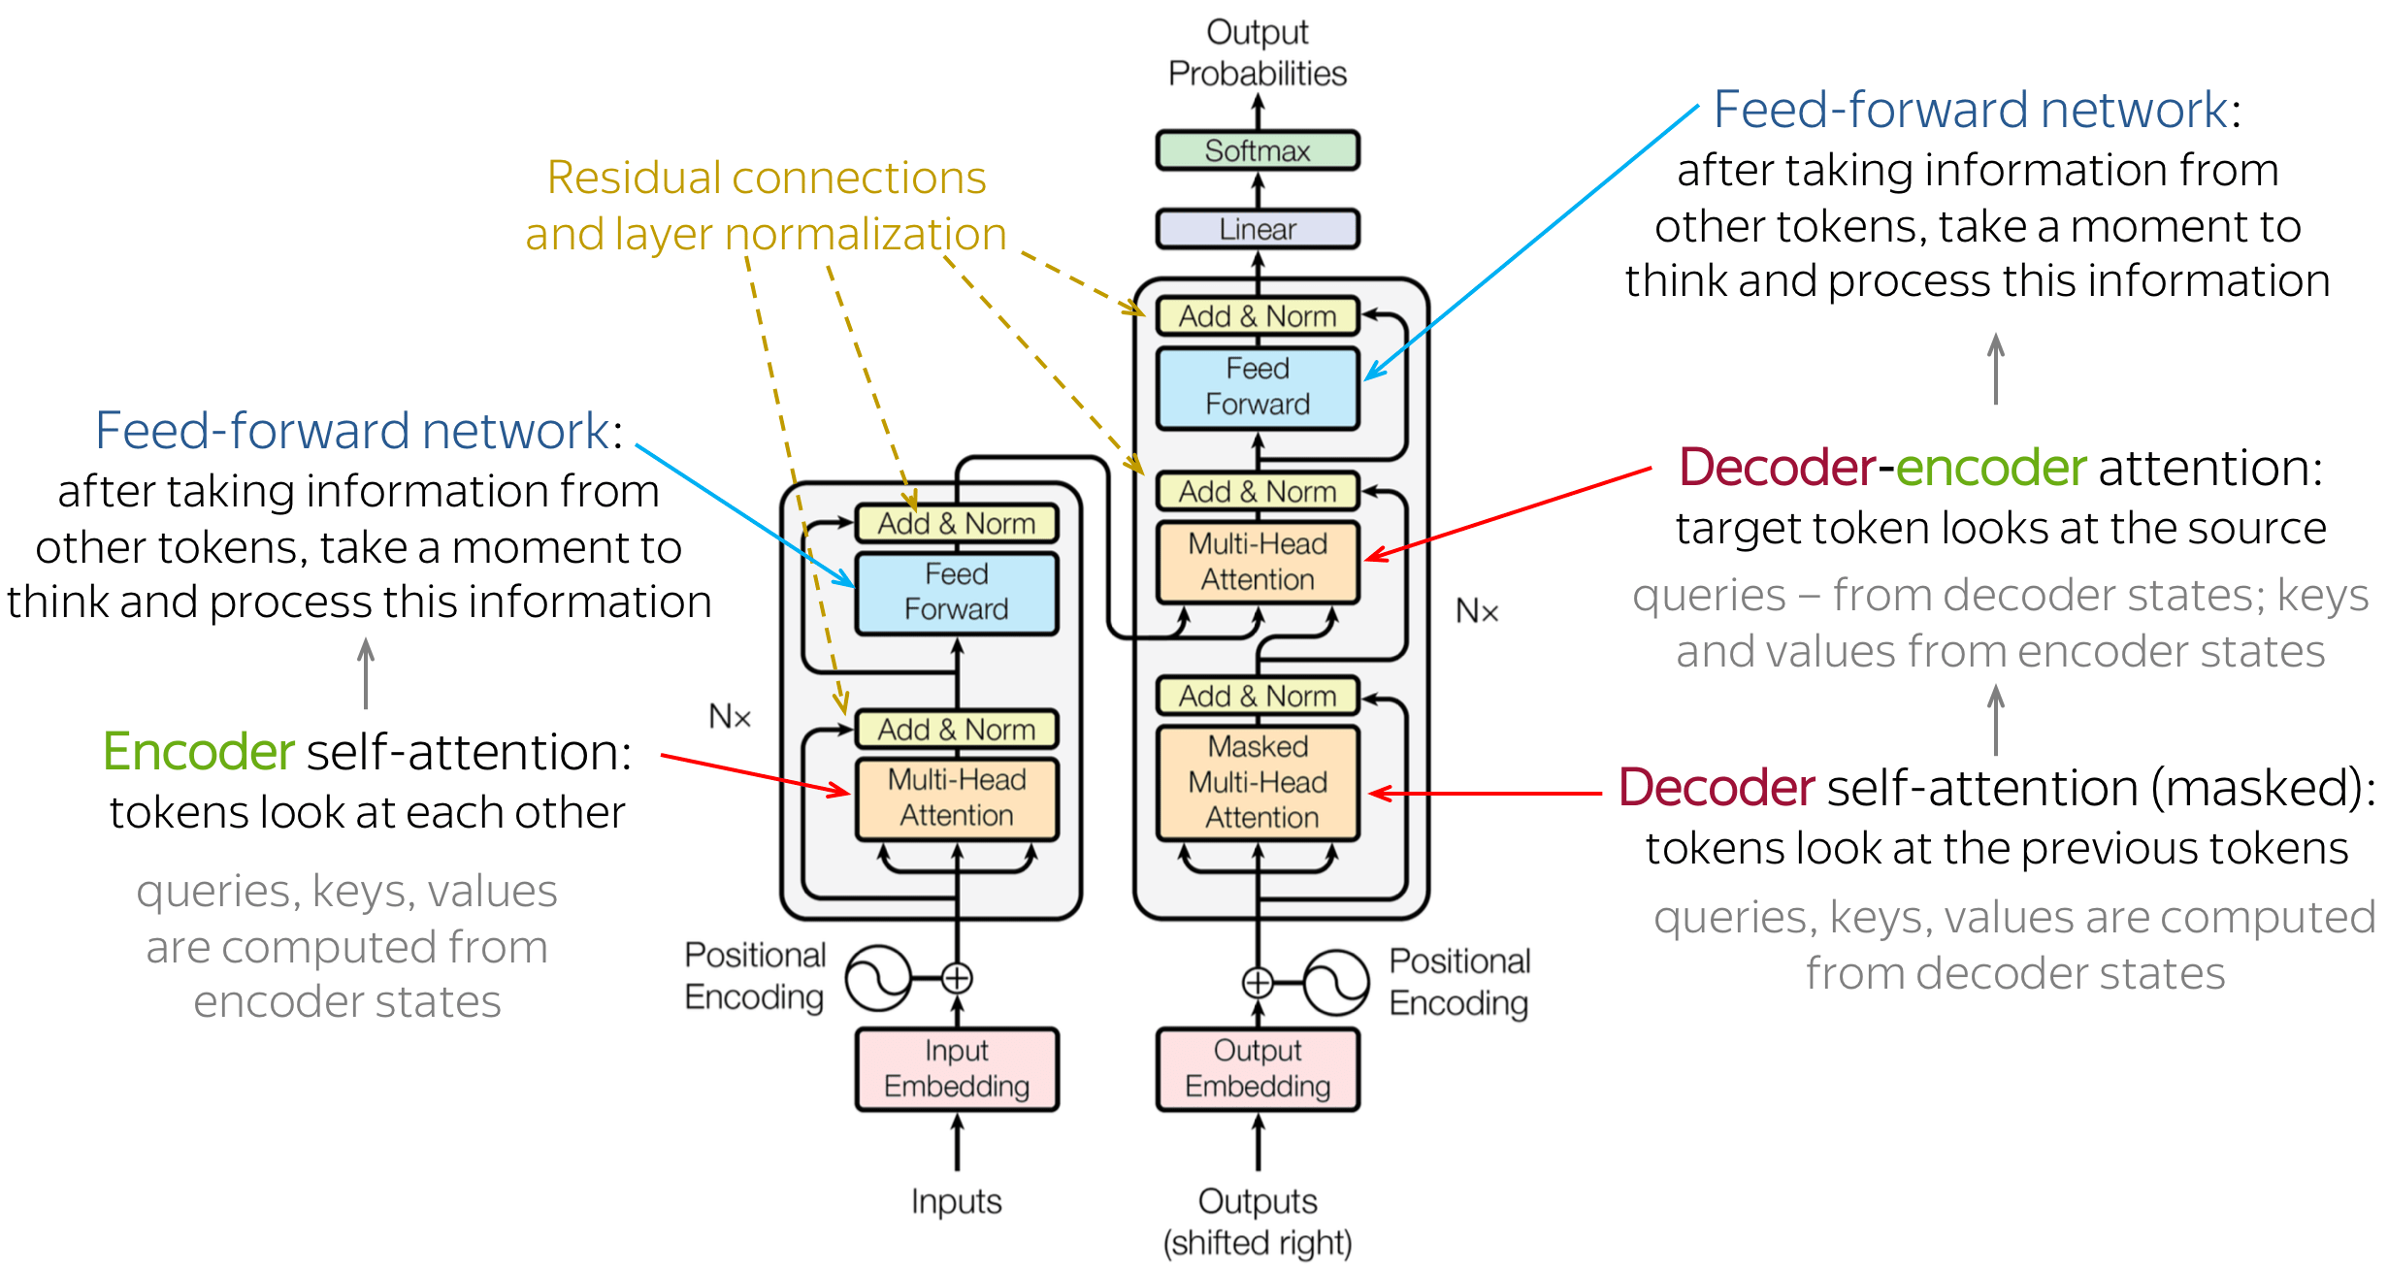
Full Transformer NN is more complicated ofc...
And you haven’t learned working with RNN’s so stop here...
But you get the point

Slide 49
Transformers Networks are different...
The cat eats the mouse → [Target Sentence in German]
The transformer network can pay attention to the most relevant hidden state
Which is the hidden state where the word ‘eats’ was just encoded
Note that the decoder no longer looks at H6, therefore the path length is much smaller and the transformer is smarter and faster!
[0,0,0] [0,0,0] [0,0,0,0] [0,0,0] [0,0,0,0,0]
E
E
E
E
E
H
Start
H0
H1
H2
H3
H4
Die Katze frisst
D
D
D
H5
H6
Notes:
We would start by encoding the sentence to vectors and then decode it again. Somehow, the sentence needs to go into a vector. Translating these is traditionally called a sack-to-sack task

Slide 50
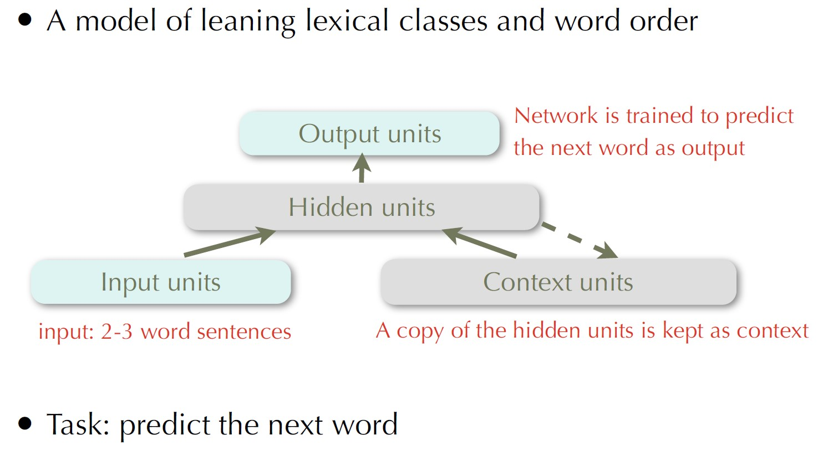
Although people have been doing it before google...
Elman (1990): Language Modelling - Phonological

Slide 51
So what are humans doing when forming/consuming language?
Predicting the piece of information!
It can be a lot of fun:
Predicting how a film is going to end
Predicting the pattern of a game character
Predicting the next sound in a song
Predicting the next value in sudoku
Fun == Pattern recognition and prediction! :D

Slide 52
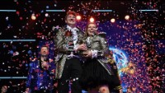
Music can be very intuitive to predict!

Slide 53
That’s it for this block!
Any questions?

